Slide 1

ED-Optimiser
Online triage tool with mobile and web platforms
Team Scrubs

Slide 2

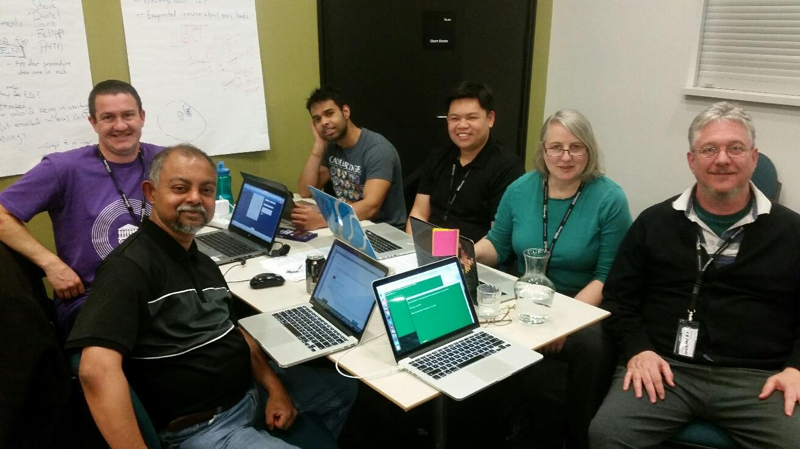
Team Scrubs
Stephen Gray | Arin Basu | Feby Perumbally | Daniel Chong | Jane Ross | Felipe Voloch

Slide 3
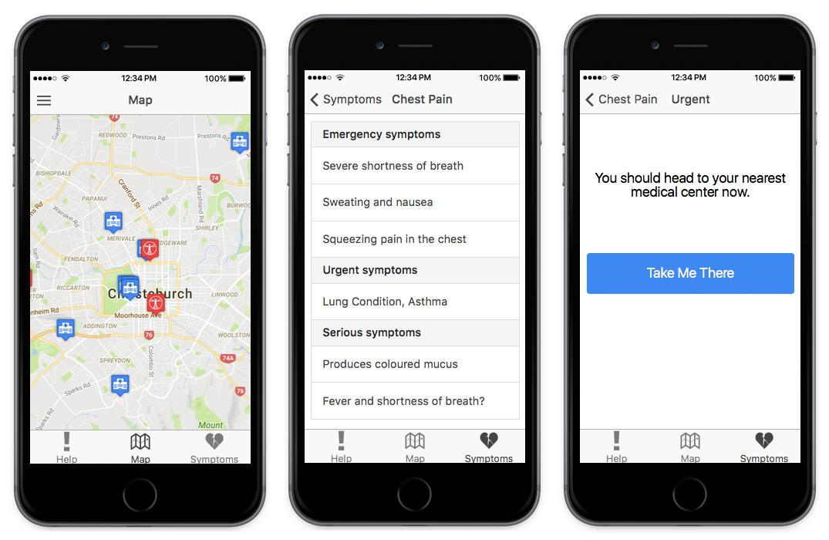
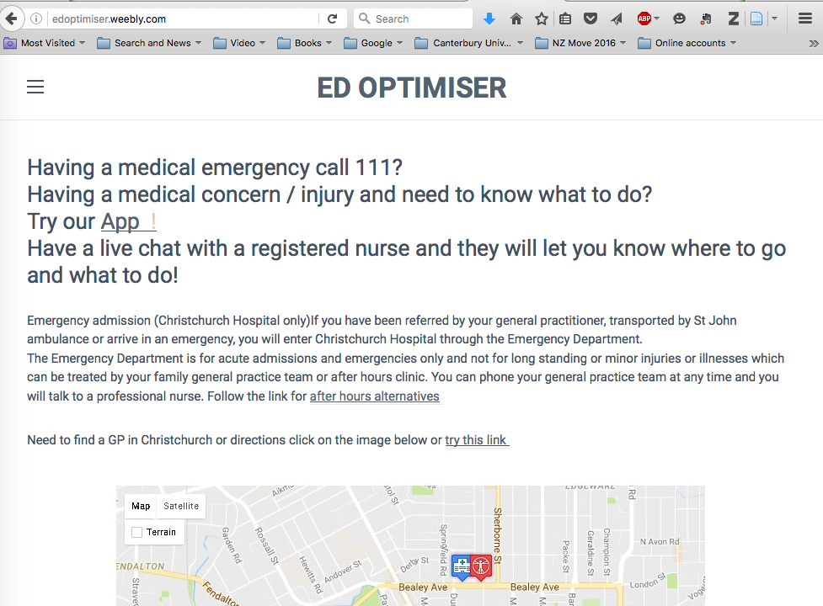
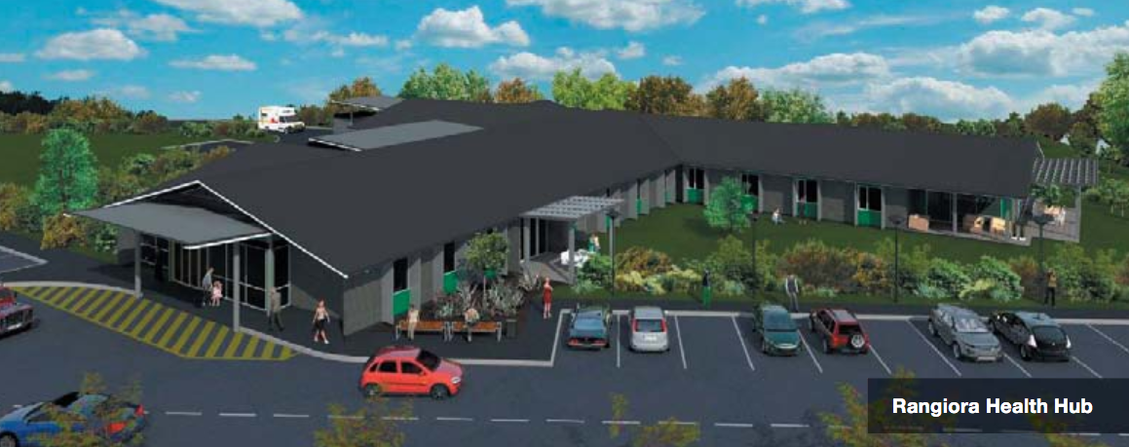

Slide 4
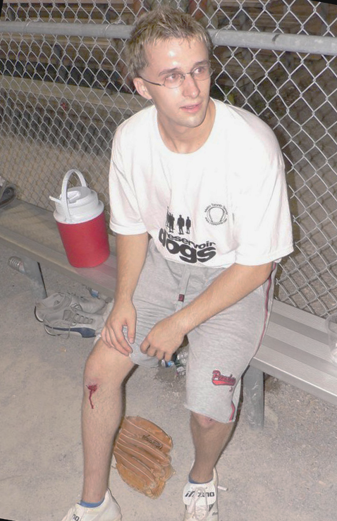
The Problem: Help CDHB optimise ED use
Millennials are using CDHB emergency departments
more than other age groups
for conditions that could be treated at the GP or in an after-hours clinic.
How can we redirect them to health-care providers that will free up EDs for real emergencies?
Image source: Flickr, CC (Attribution) 2006 by Slava

Slide 5
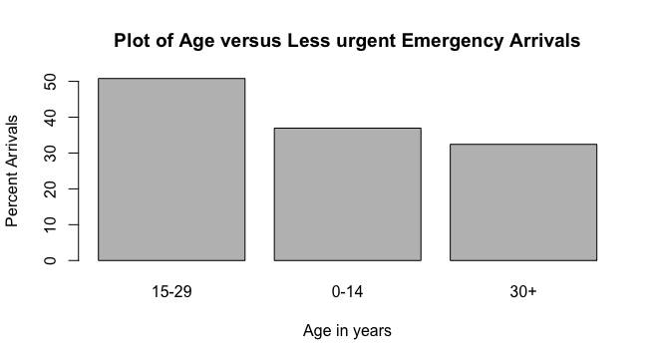
The Focus: Millennials (15–29 year olds)

Slide 6
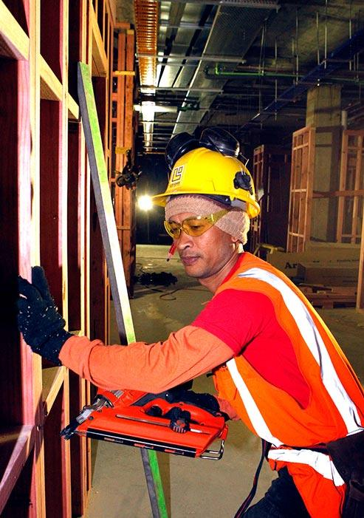
Our Target Group
15–29 year olds who have not already signed up with a GP in the CDHB district
What do we know about them from the data?
Some are kiwi “Young invincibles”
Some are foreign construction workers
Some are “fly-in fly-out” commuters
Use the ED on weekends and evenings
Many are low-income
Some use the ED due to cultural norms or limited English
Image source: Te Ara. Licensed by Manatū Taonga Ministry for Culture and Heritage for re-use under the Creative Commons Attribution-NonCommercial 3.0 New Zealand Licence.
Notes:
Young invincibles have no chronic health conditions and do not anticipate needing medical care

Slide 7
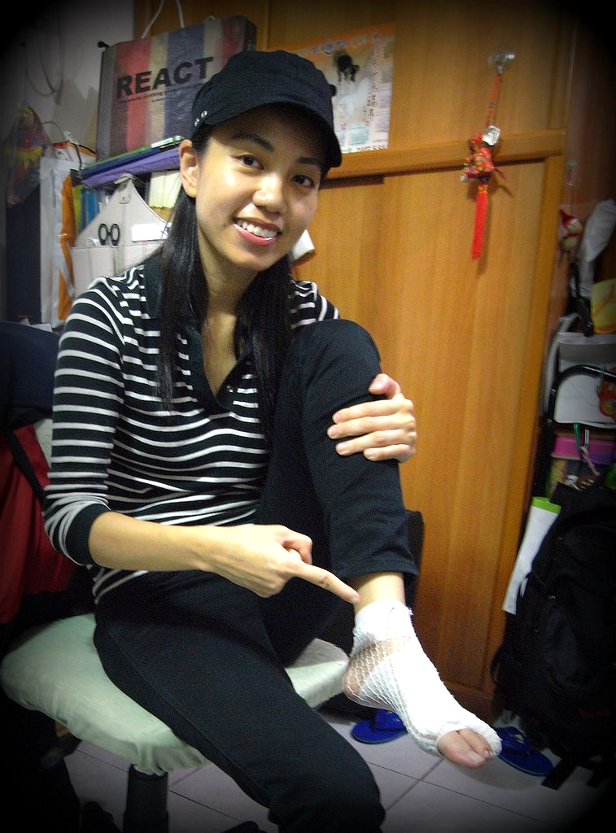
Why are these patients using the emergency room?
Cost:
ED is a cheaper alternative.
Lack of knowledge:
of the health system
of how to register with a GP
Overblown concern regarding symptoms:
Less experience with injury
Exaggerated sense of the danger of an injury
Online self-diagnosis may heighten fears
Image source: Flickr, CC (Attribution) 2010 by Momo
Notes:
Cost:
Emergency Department is seen as a cheaper alternative.
Knowledge:
Younger generation do not know how the health system works or even that they need to be registered with GP
Overblown concern regarding symptoms:
Less experience with injury and exaggerate response.

Slide 8
Problem Solution
The ED is free to users.
Millennials don’t understand the healthcare system
They sometimes have an overblown concern over their injuries and illness

Slide 9
Problem Solution
Millennials don’t understand the healthcare system
They sometimes have an overblown concern over their injuries and illness
Easy, fast access to personalised health info from live CDHB nurses

Slide 10
Problem Solution
The ED is free to users.
Millennials don’t understand the healthcare system
They sometimes have an overblown concern over their injuries and illness
Easy, fast access to personalised health info from live CDHB nurses
Supply instant information through mobile app

Slide 11
Data and technologies we’ve used
Data sources: CDHB GovHack data files, NZ census data
Data analysis: R
App wireframe mockups: ionic.io
Diagnostic flow chart info: FamilyDoctor.org
Website development: weebly.com
Slide presentation: Google Slide, PhotoShop, Flickr.com
QR code: QR-Code-Generator.com, Image-QR.com
Video: ScreenRecorder from Rylstim, PremierePro

Slide 12
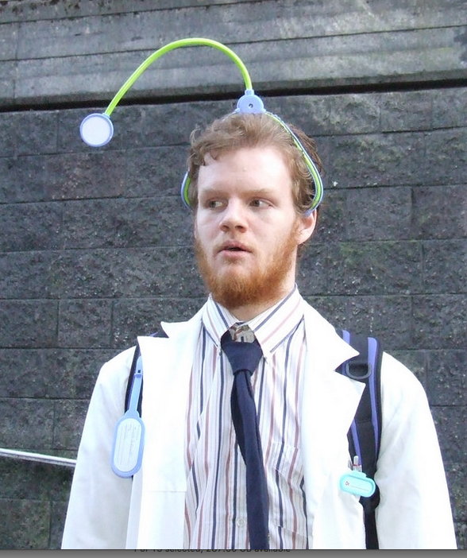
What behaviour change do we want to promote?
Millennials will:
Start to use HealthLine as a first point of contact with the health system.
Enroll with GPs
Gain awareness of health-care providers in CDHB district other than EDs
Gain awareness of health and healthcare needs
Image source: Flickr, CC (Attribution) 2007 by Murray Barnes

Slide 13
Triage alternatives for millennials
Our app will incentivise millennials to step through three stages of triage before they opt for the ED:.
Self-triage using a symptom checker
Cellphone call to HealthLine or online chat with video/photos
In person at an express ED triage centre that they must sign into via the app; and last, if all these fail…
Emergency department

Slide 14
Our solutions
Two-pronged approach: Mobile app, supported by a web presence
Mobile app (integrated into the SmartCity app)
Information on the health system
Direct call button to call HealthLine
Symptom checker
Map and navigation to health-care providers
In-app appointment setting and option to sign-up for a GP
Live chat with a nurse
App is integrated with data on health-care providers, ED wait times, availability of GPs
Sends user self-diagnostic symptoms to medical center the patient has chosen

Slide 15
ED-Optimizer App
https://creator.ionic.io/share/81361182e73a

Slide 16
Website

Slide 17
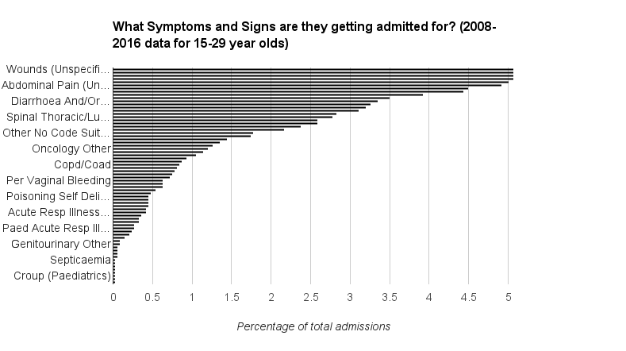
Symptoms

Slide 18
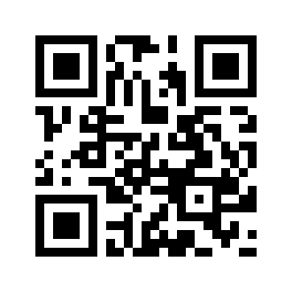
Marketing Plan
Advertise with image QR codes linking to the website and app:
To students who are leaving university
To workers via employee induction kits
To customers in chemist shops and supermarkets
Create incentives for millennials to download the app
Make sure after-hours clinics are destinations in augmented reality games.

Slide 19
Wishlist — How could this be evolved and expanded?
Send data collected by the app back to CDHB
Integrate reviews of doctors and clinics
Integrate health tips customised for each user
Roll out to all district health boards; make it NZ-wide

